Slide 1

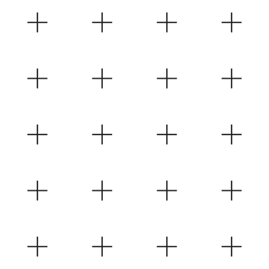



HTML Crash Course – 1 Day
Sean Wong
2025/08/04

Slide 2

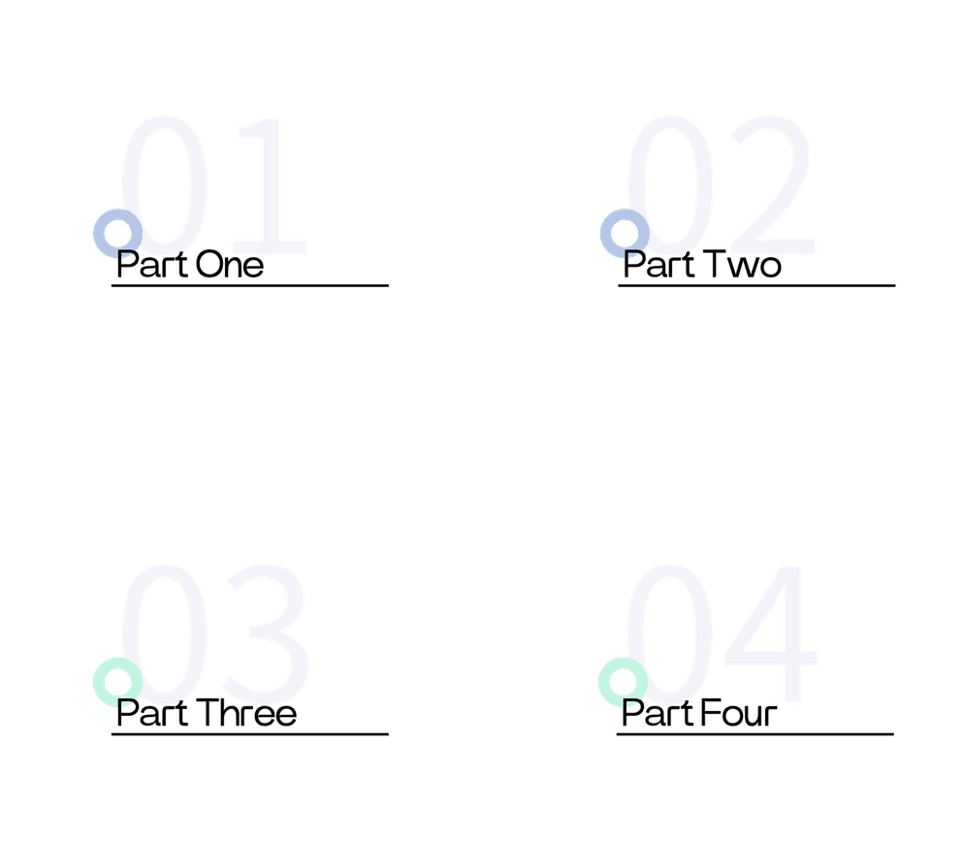
CONTENTS
Quick Start
Core Tags
Structured Data
Practice & Resources

Slide 3

Quick Start

Slide 4

HTML Crash Course – 1 Day
Learning Goals
By the end of this course, you will be able to create a basic webpage structure, add text and images, and understand the importance of semantic HTML. Let's dive in!
Course Overview
Welcome to the HTML Crash Course! In just one day, you'll learn the essentials of HTML and build your first webpage. This course is designed for beginners with no prior coding experience.
Your Instructor
I'm [Your Name], your instructor for today. I have years of experience in web development and am excited to guide you through this crash course. Let's get started!

Slide 5

What is HTML?
Definition
HTML stands for HyperText Markup Language. It is the standard language used to create the structure and content of webpages. Every website you visit is built using HTML.
Role in Web Development
HTML works hand-in-hand with CSS for styling and JavaScript for interactivity. Together, these technologies form the foundation of modern web development.

Slide 6

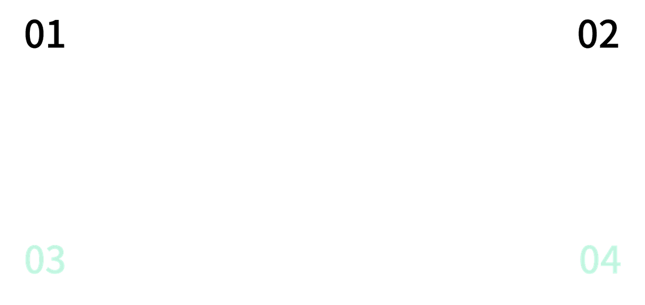
Setting Up Your Workspace
Code Editor
Basic HTML Structure
To get started, you'll need a code editor. Popular choices include VS Code, Sublime Text, and Atom. These tools help you write and manage your HTML code efficiently.
Every HTML document starts with the <!DOCTYPE html> declaration. This is followed by the <html> element, which contains the <head> and <body> sections.
Creating Your First HTML File
Title and Body
Create a new file named index.html. This will be the main file for your webpage. Open it in your code editor to start coding.
Inside the <head>, add a <title> tag to set the title of your webpage. The <body> section is where you'll add all the content that will be visible on the page.

Slide 7
Core Tags

Slide 8




Headings
Use headings to structure your content. HTML provides six levels of headings, from <h1> to <h6>. <h1> is the most important and <h6> is the least.
Paragraphs
Text & Headings
Paragraphs are defined with the <p> tag. They are used to group text into logical blocks, making your content easier to read and understand.
Formatting
Enhance your text with <strong> for bold, <em> for italics, and <mark> for highlighted text. These tags help emphasize important information.

Slide 9

Lists & Links
Lists
Links
Create lists with <ul> for unordered lists and <ol> for ordered lists. Each item in the list is wrapped in <li> tags. Lists help organize information clearly.
Add links using the <a> tag with the href attribute. Links can be internal, pointing to other sections of your page, or external, linking to other websites.

Slide 10

Images & Multimedia
Audio
Add audio files using the <audio> tag with the controls attribute. This allows users to play and pause the audio directly on your webpage.
Images
Insert images with the <img> tag. Use the src attribute to specify the image file and alt attribute for alternative text, which is important for accessibility.
Video
Embed videos with the <video> tag. Like audio, use the controls attribute to provide playback controls. This is a great way to enrich your content.
Multimedia Tips
Ensure your multimedia files are optimized for the web to avoid slow loading times. Always provide fallback content for users who cannot access the media.

Slide 11
Structured Data

Slide 12

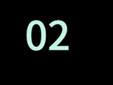



Creating a Table
Start with the <table> tag. Add rows with <tr>, headers with <th> in the first row, and data cells with <td> in subsequent rows.
Tips for Tables
Table Structure
Use the scope attribute in <th> tags to define whether a header is for a row or column. This improves accessibility and clarity.
Tables are used to display tabular data. They consist of rows (<tr>), headers (<th>), and data cells (<td>). Properly structured tables make data easy to read.
Building Tables

Slide 13


Creating Forms
Labels and Textareas
Form Basics
Pair each input with a <label> for better accessibility. Use <textarea> for multi-line text input, such as comments or messages.
Forms are used to collect user input. Use the <form> tag to create a form. Inside, you can add various input fields.
Input Types
Dropdowns
Use <input type='text'> for text input, <input type='email'> for email addresses, and <input type='submit'> to create a submit button.
Create dropdown menus with the <select> tag. Each option is defined with the <option> tag. This is useful for selecting from a list of items.

Slide 14
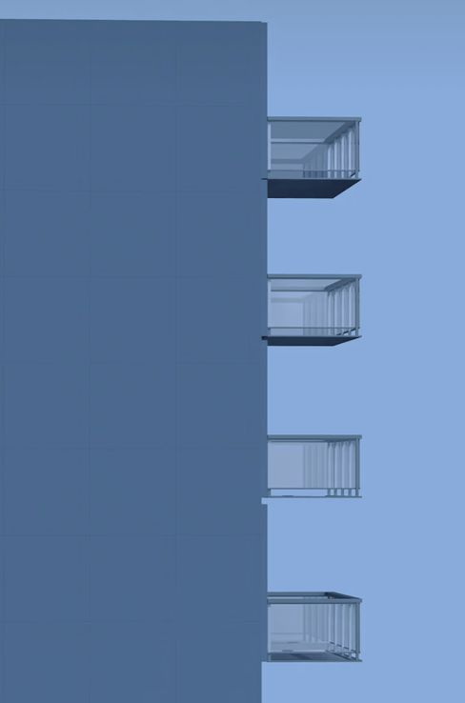
Semantic HTML
Semantic Tags
Semantic HTML uses tags like <header>, <footer>, <nav>, <main>, <section>, <article>, and <aside> to define the structure of your webpage.
Benefits
Semantic HTML improves accessibility, making your webpage easier to navigate for users with disabilities. It also enhances SEO, helping search engines understand your content.

Slide 15
Practice & Resources

Slide 16

Hands-On Project
Project Overview
Now it's time to apply what you've learned. Build a multi-section webpage with headings, paragraphs, links, lists, images, forms, and semantic layout. This hands-on project will solidify your understanding.

Slide 17


Best Practices
Use Semantic Tags
Meaningful Alt Text
Clean Code
Always use semantic HTML tags to improve the structure and accessibility of your webpage. This makes your code more readable and maintainable.
Write descriptive alt text for images. This helps users who rely on screen readers and improves SEO by providing context for search engines.
Keep your code clean and well-indented. This makes it easier to read and debug. Test your webpage in multiple browsers to ensure compatibility.

Slide 18





Further Learning Resources
MDN Web Docs
Practice Platforms
For comprehensive HTML documentation, visit MDN Web Docs. It provides detailed guides, examples, and best practices for web development.
Practice your HTML skills on CodePen and JSFiddle. These platforms allow you to experiment with code and see the results in real-time.

Slide 19



Sean Wong
2025/08/04

